Slide 1

Machine Learning For Algorithmic Trading of SPY
Brittany Jacques, Debolina Mukherjee, Glenn Kees, Jaime Barrigan, Paul Rodriguez
Notes:
Debolina

Slide 2
Hypothesis
Since the reliance of technical analysis on charts, price action, and volume – we hypothesized through algorithmic trading and a signal identification bot we could streamline the order execution and decision-making process for investors.
Notes:
Debolina

Slide 3
Motivation & Summary Slide
Team interest in developing an algorithmic trading strategy to help automate the decision-making and execution of intraday trading against the SPY ETF (tracks S&P 500)
Leveraging the Alpaca Trading API (for historical data) and the SuperTrend indicator strategy to generate buy/sell signals for intraday trading and to automate order execution
Integrating the Amazon DeepAR Forecasting algorithm as a real-time trading signal confirmation to use in concert with the automated buy/sell execution of the SuperTrend Trading Bot
We were able to train, test, and run our model against live trading data on 12/10/21 but model proved to be ineffective due to poor forecasting by DeepAR model
Notes:
Brittany:
This project involved developing an algorithmic trading strategy to help automate the decision-making and execution of intraday trading against the SPY ETF (tracks S&P 500). The solution leverages Alpaca Trading API (for historical data) and the SuperTrend indicator strategy to generate buy/sell signals for intraday trading and to automate order execution. Furthermore, the Amazon DeepAR Forecasting algorithm was integrated as a real-time trading signal confirmation to use in concert with the automated buy/sell execution of the SuperTrend Trading Bot.
12/09/21 was a down day for SPY and due to the long-only strategy this did not generate any signal s

Slide 4
Model Summary
A ”SuperTrend” indicator provides precise buy and sell signals during a trending market
Our strategy utilized the SuperTrend indicator with a long-only trading approach with a 15-minute timeframe to generate trade signals
The integration of DeepAR forecasting algorithm for additional signal confirmation when executing trades
Bot created in a simple notebook framework and leverages Python scheduler within Jupyter Notebook
PROS & CONS OF SUPERTREND INDICATOR
Easy to understand and visualize
Enables faster decision making
Accurate signals on precise time
Works well with trending markets
Not effective during A/D phases
Notes:
*Speak sideways for pros then go through bullet points* The choice for using this indicator was due in part to several reasons. Namely, we wanted an approach that was easy to understand and flexible for many timeframes. Additionally, we liked that it provides precise buy and sell signals and works well with a trending market. Since the scope of our project was time-constrained, we opted to implement a "Long-only" trading strategy.

Slide 5
Data Exploration & Clean up
Initially we needed to decide on the API, cloud hosting platform, and machine learning algorithm to incorporate into the development of the bot.
Alpaca Trading platform was chosen due to team’s familiarity and its user-friendly interface and product offerings.
SageMaker studio was chosen so we could model and train host machine learning algorithm in one place.
Jupyter notebook was used to develop the SuperTrend trading bot.
Notes:
Paul:
Describe the exploration and cleanup process.

Slide 6
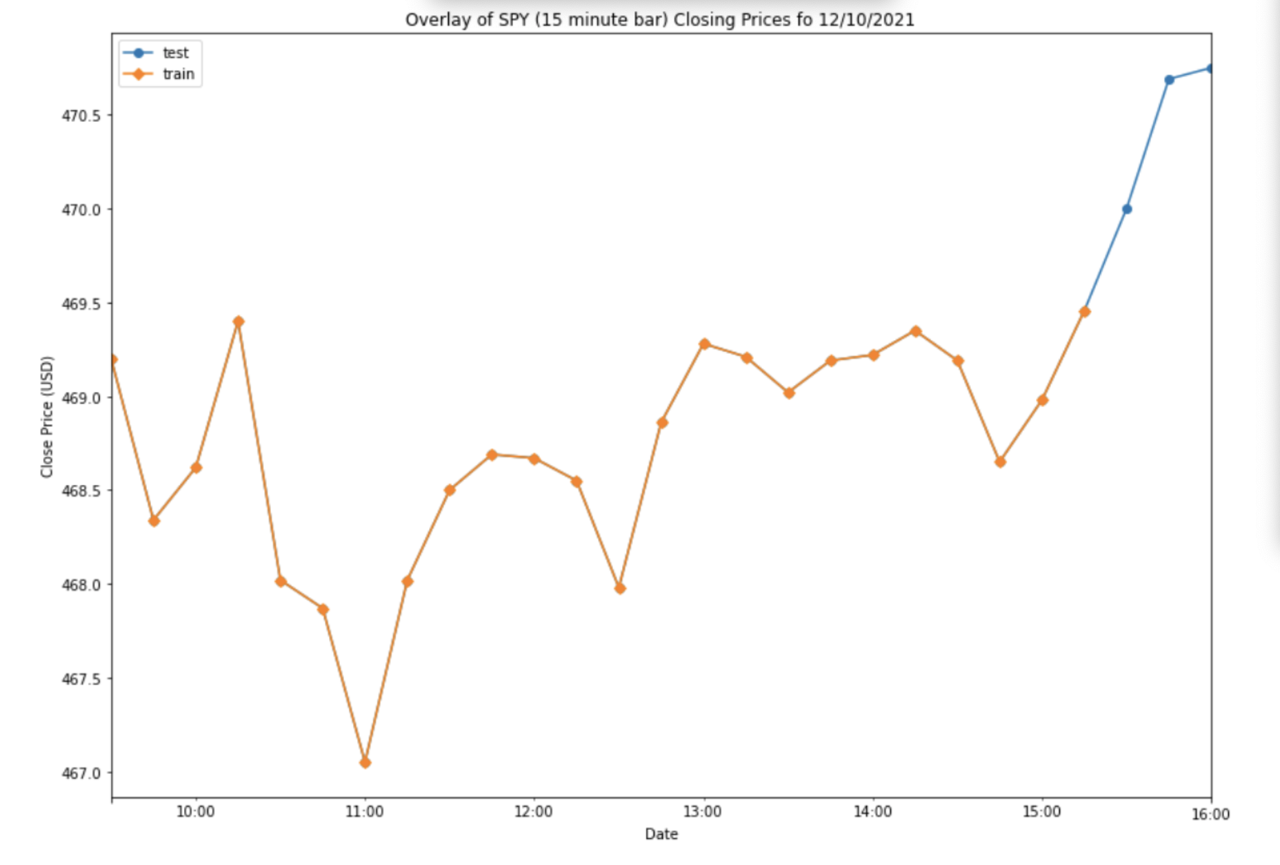
Model Training
The Amazon AWS SageMaker endpoint hosting was used for model prediction.
SageMaker Studio was used to train the DeepAR forecasting model.
The training process was tedious and ultimately took several minutes per iteration.
We found SageMaker more difficult than Jupyter notebook development.
Notes:
Paul:
The Supertrend indicator requires no model training, only the implemetation of the Supertrend Indicator Formula. According to documentation, the indicator works very well in trending markets. The buy signal is generated with the "Super Trend" closes below the most recent close price. Similarly, the sell signal is generated when the "Super Trend" closes above the most recent close price. Lastly, this trend indicator can be combined with other approaches to generate even "better" signals. That is what we endeavored to find out here...
The DeepAR Forecasting algorithm was selected as it is a supervised learning algorithm for forecasting scalar time series such as stock market closing prices. This, theoretically, will allow for the model to extrapolate the time series data into the future for complementary trading signal confirmation. Moreover, DeepAR outperforms standard ARIMA and Exponential Smoothing techniques when datasets contain hundreds of related time series. Figure 2 depicts is a visual overlay of train and test datasets for a given time series (1 day sample at 15 minute timeframe).

Slide 7
Model Evaluation
DeepAR Forecasting Model - Varied the following hyperparameters: - number of epochs - number of cells/layer - number of layers in network - learning rate - batch size
Validated changes using the following metrics: - Root Mean Squared Error (RMSE) - Mean Quantile Loss
SuperTrend Trading Indicator: Live Trading conducted against a paper trading account
Notes:
Jaime:
The DeepAR Forecasting model uses various hyperparameters to allow for tuning and optimization of the neural network (RNN) and evaluates the trained model using the root mean squared error (RMSE) over the test data. Additionally, the algorithm evaluates the accuracy of the forecast distribution using weighted quantile loss.

Slide 8
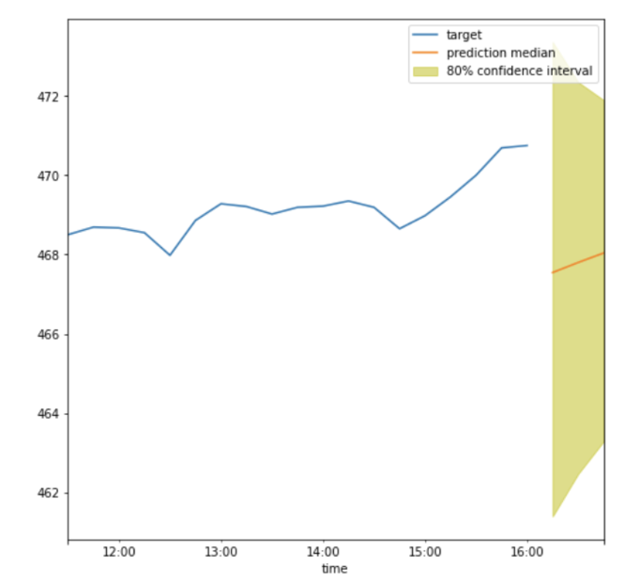
Findings & Discussion
From the live trading session, the Supertrend Indicator strategy worked well in identifying Buy/Sell signals at a 15-minute timeframe
The DeepAR Model did not appear to be effective in forecasting prices with a narrow enough confidence interval to be useful
Because the strategy was long only, there was a day where no trade signals were generated
Notes:
Glenn:
Discuss your findings. Was the model sufficient for the predictive task? If not, why not? What inferences or general conclusions can you draw from your model performance?

Slide 9
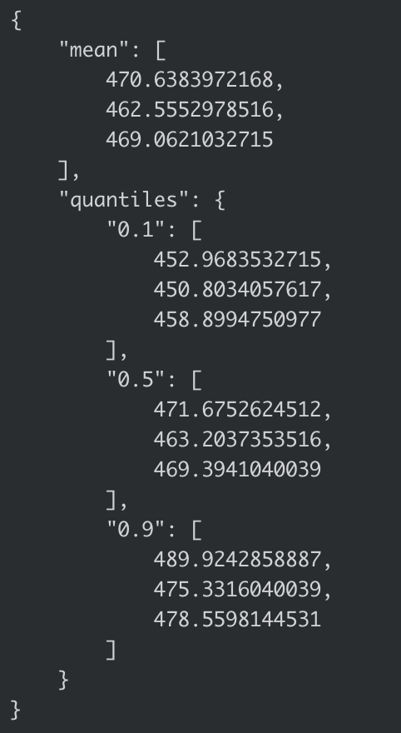
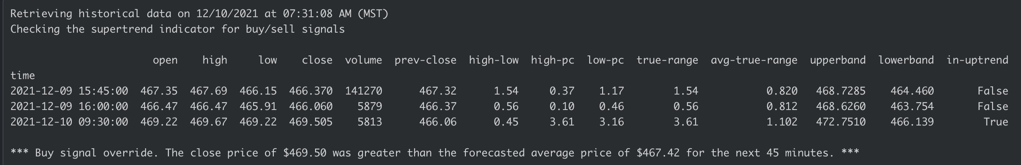
Numerical Findings
While the SuperTrend signals were functioning as expected the DeepAR forecast model conflicted with the signal. Our implementation required all signals to confirmed before the trade could be executed.
Notes:
Glenn

Slide 10
Postmortem
We attempted to create a code that would allow for us to place short orders within the Alpaca Trading API. However, this never came into fruition due technical complications
DeepAR trading – lack of familiarity with the required JSON lines format and structure slowed progression
SageMaker outages that caused delays in process
Using tester code initially and having to rewrite the variables to correspond with the Alpaca Trading API
Future Improvements
Model selection and tuning.
Better use of forecasting approach.
Considering additional trending indicators for better precision.
Shorter timeframes.
The incorporation of short trading strategy.
Notes:
Jaime:
Discuss any difficulties that arose, and how you dealt with them.

Slide 11

Questions

